Slide 1
Ense 470 milestone 7
Jeremy Cross
Iden Ellia
Abdullah Alasmari

Slide 2
Introduction
We will be reviewing Team Covfefe’s application
www2.cs.uregina.ca/~thoma26s/ense470/splashpage.php

Slide 3
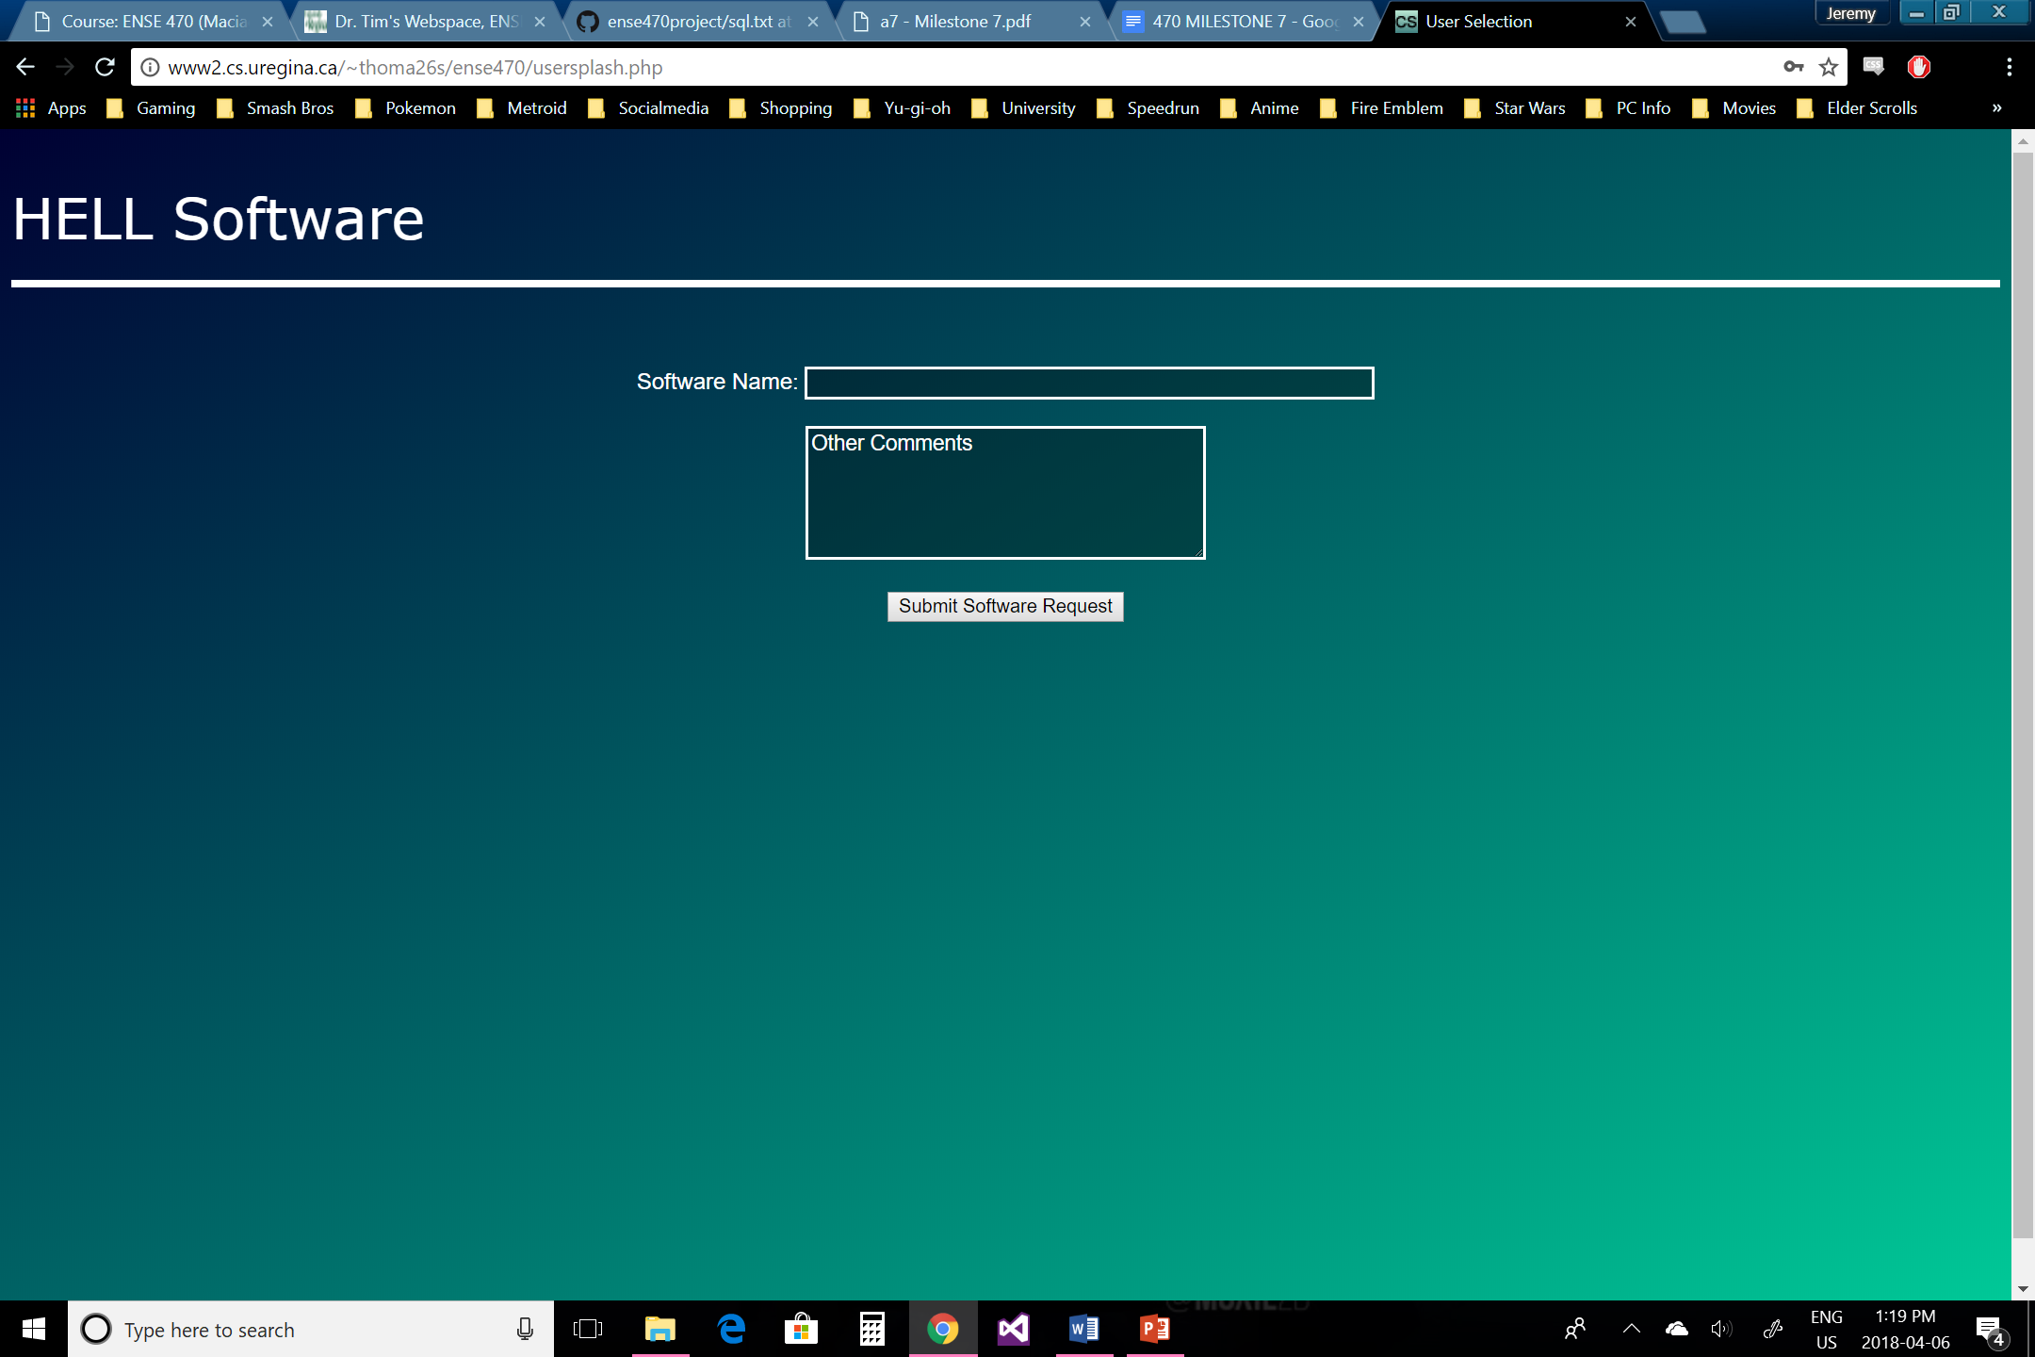
User Perspective

Slide 4
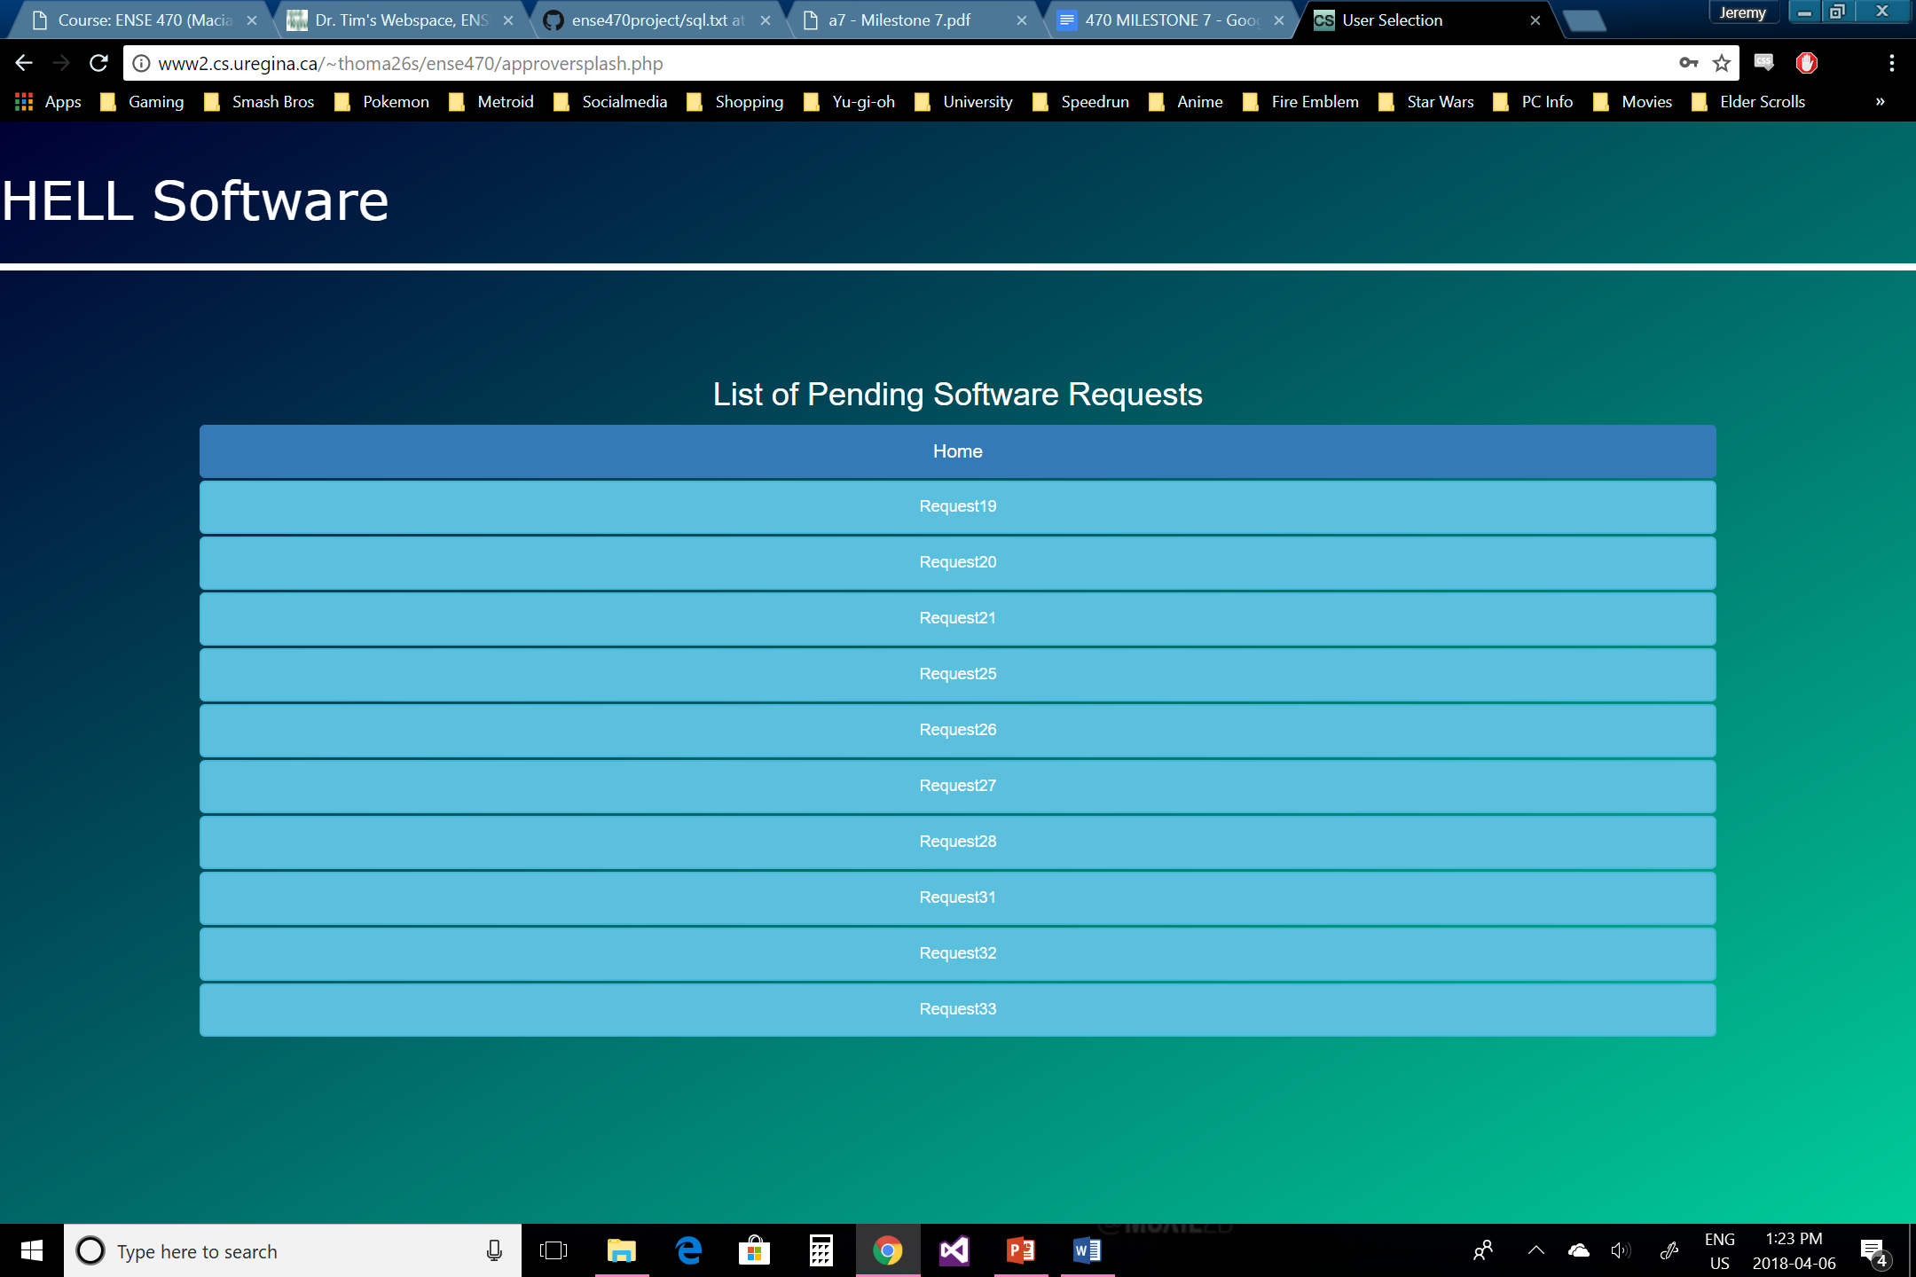
Approvers Perspective

Slide 5
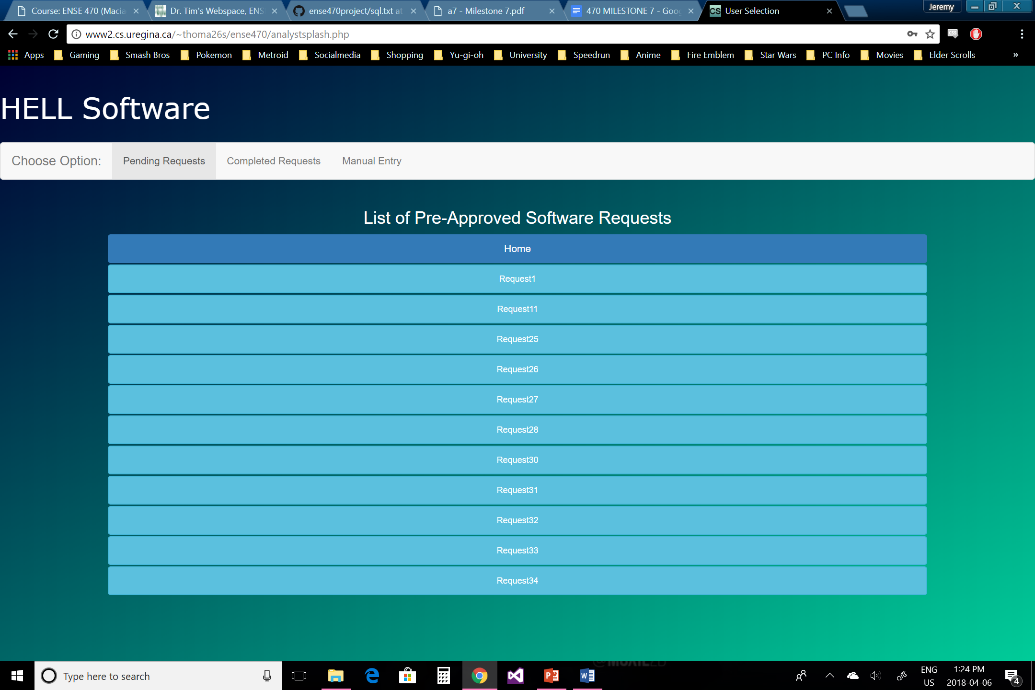
Analyst perspective

Slide 6
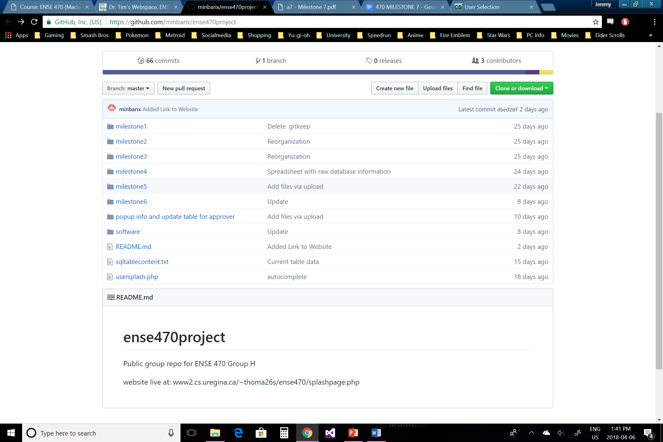
Team covfefe github review
There GitHub page well organized with everything having its own folder
The folder names are labeled correctly and correspond to what's in them
The documentation could maybe provide a bit more detail
Shouldn’t be to hard to pick up where they left off
Overall the organization of the GitHub page is good and it wasn’t to difficult to find where to locate things

Slide 7
Refactor review
Code
They used HTML, CSS, JavaScript, MySQL, PHP, AJAX
ATDD templates
In total there were 6 different tests with 16 tests cases
Most of the tests passed/failed as intended
All the templates are accounted for on the user story map
Templates are accessible through the milestone 5 and 6 presentations but were not posted individually, However, they were not to difficult to find

Slide 8
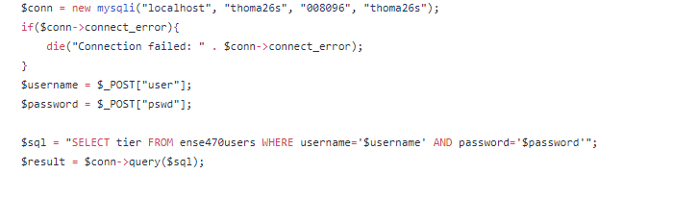
Refactor Review
Code Smells
User input for variables can prove to be an insecure environment allowing users to login with any credentials using an sql expression, or even dump the database.

Slide 9
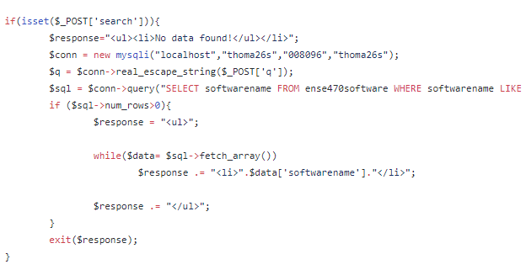
Refactor review
Code Smells
Not using different files for the MYSQL session, this enables a lot of code reuse.

Slide 10
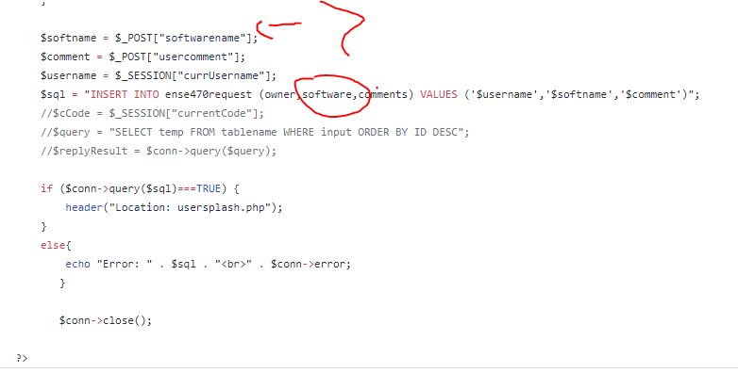
Refactor Review
Code Smells
There are only client-side checks for requesting software.

Slide 11
Refactor review
Refactoring Methods
Separating code for reuse, there are a lot of methods that implement the same code
Incorporate OOP paradigm in order to maintain a loosely coupled design using PHP classes
Use Observer pattern to notify users of pending and active requests
Use Factory pattern to instantiate objects for different types of authentication
Have authentication objects inherit from the same abstract parent, allowing an abstract method to be chosen at runtime
Add server-side validation to reduce spam and prevent users from making invalid requests

Slide 12
Design pattern discussion (High-level focus)
The design pattern they used are :
Strategy – was used to determine what type of user is logged in, either user approver or analyst
Façade – was used to complete a request from the user’s perspective
Observer – was used to notify analysts and approvers of software that needed to be handled

Slide 13
Group reflection
How did you feel about this milestone? What did you like about it? What did you dislike?
It was interesting looking at a different approach to designing the application
It provides different perspectives seeing different design approaches
What did you learn about yourself as you collaborated and worked through this milestone?
We learned how to use refactoring Techniques which help to change messy code to more clean and simple code.
How will you use what you have learned going forward?
We can use the feedback that we receive for the group reviewing our application as well as ideas from reviewing team Covfefe’s application in the future
What “stuff & things” related to this milestone would you want help with?
For the most part we were fine

Slide 14
Reviewed teams response
Comments or Questions?

